Slide 1

HOUSE PRICE PREDICTION
FINAL YEAR PROJECT
ITB03
SUSHANT KULKARNI
SHEFIN SHAJIT
AKSHAY MOHITE
GUIDED BY: Dr. SWATI SINHA

Slide 2
INTRODUCTION
HOUSING ACCOUNTS HIGH PERCENTAGES OF NATIONAL TRANSACTIONS PER YEAR
NEED AND THE FUNCTIONING OF OUR SYSTEM
ATTENTION TO VARIOUS FACTORS AFFECTING HOUSING PRICES

Slide 3
AIM
OBJECTIVES
PREDICT THE HOUSE PRICE FOR THE USER WITH RESPECT TO VARIOUS FACTORS AND PRIORITIES AFFECTING THE PRICE
LITERATURE SURVEY
HOUSE PRICE PREDICTION
ENSEMBLE LEARNING (ML)
COMBINATION OF MODELS AND TRAINING
WEBSITE DESIGNING
USER INTERFACE
CONTRIBUTE TO THE LITERATURE
PAPER PUBLISHING
ANALYSIS OF MARKET TRENDS AND PRICE RANGES

Slide 4
PROBLEM STATEMENT
TO DEVELOP A SYSTEM THAT WOULD HELP THE USER TO PREDICT THE
PRICE FOR A PARTICULAR HOUSE TO MAKE A SMART INVESTMENT
DECISION.
THE SYSTEM SHOULD CONSIDER THE
REAL-LIFE FACTORS SUCH AS LOCATION OF THE HOUSE AND THE CONNECTIVITY,
LEISURE SERVICES, SCHOOLS ETC. THAT AFFECT THE PRICE OF THE HOUSE ALONG WITH THE
FEATURES OF HOUSE AND THE AMENITIES AVAILABLE.

Slide 5
LITERATURE SURVEY
SR. NO.
TITLE
AUTHORS
OBSERVATION
HOUSE PRICE PREDICTION USING
MACHINE LEARNING AND
NEURAL NETWORKS.
AYUSH VARMA, SAGAR DOSHI,
ABHIJIT SARMA, ROHINI NAIR
INSTEAD OF AN INDIVIDUAL ALGORITHM
A SERIES OF ALGORITHM
YIELDS BETTER RESULTS.
01.
02.
HOUSE RESALE PRICE PREDICTION
USING CLASSIFICATION ALGORITHMS
P. DURGANJALI, M. VANI PUJITHA
ADA BOOST ALGORITHM HAS
HIGHEST ACCURACY
02.
HOUSE RESALE PRICE PREDICTION
USING REGRESSION TECHNIQUES:
A COMPARATIVE STUDY
CH. RAGA MADHURI, G. ANURADHA,
M. VANI PUJITHA
GRADIENT BOOSTING ALGORITHM HAS
HIGHEST ACCURACY

Slide 6
LITERATURE SURVEY
SR. NO.
TITLE
AUTHORS
OBSERVATION
HEDONIC MODELLING,
HOUSING SUBMARKETS
AND RESIDENTIAL VALUATION
A. ADAIR, J. BERRY, W. MCGREAL
IDENTIFICATION OF VARIABLES HAVING
THE MOST SIGNIFICANT INFLUENCE ON
VALUE AND THE COMBINATION
OF VARIABLES ENTERING INTO THE FINAL
MODELS.
04.
05.
A PREDICTION COMPARISON OF
HOUSING SALES PRICES BY
PARAMETRIC VERSUS SEMI-
PARAMETRIC REGRESSIONS
O. BIN
THE RESULTS SHOW THAT THE SEMI-
PARAMETRICREGRESSION OUTPERFORMS
THE PARAMETRICCOUNTERPARTS IN BOTH
IN-SAMPLE ANDOUT-OF-SAMPLE
PRICE PREDICTIONS.
06.
CAPTURING HOUSING MARKET
T. KAUKO, P. HOOIMEIJER, J. HAKFOORT
THE CLASSIFICATION ABILITIES OF TWO
NEURAL NETWORK TECHNIQUES:
SELF ORGANISING MAO (SOM) AND
THE LEARNING VECTOR QUANTISATION

Slide 7
LITERATURE SURVEY
SR. NO.
TITLE
AUTHORS
OBSERVATION
PREDICTION OF REAL ESTATE
PRICE VARIATION BASED ON
ECONOMIC PARAMETERS
LI LI, KAI HSUAN CHU
PREDICTION OF REAL ESTATE PRICE VARIATION
BASED ON ECONOMIC PARAMETERS
07.
08.
HOUSE PRICE PREDICTION USING
MACHINE LEARINING
G. NAGA SATISH, V. RAGHAVENDRAN
M.D. SUGNANA RAO, CH. SRINIVASULU
LASSO REGRESSION ALGORITHM, IN VIEW
OF ACCURACY, REALIABILITY OUTPERFORMS
ALTERNATE MODELS IN THE
EXECUTION OF HOUSING COST
PREDICTION
09.
MODELLING HOUSE PRICE PREDICTION
USING REGRESSION ANALYSIS
AND PARTICLE SWARM
OPTIMIZATION
ADYAN NUR ALFIYATIN, HILAN TAUFIQ
RUTH EMA FEBRITA, WATYAN FIRDAUS
MAHMUDY
THE RESULT FROM THIS SEARCH PROVED
COMBINATION REGRESSION AND PSO
IS SUITABLE AND GET THE MINIMUM
PREDICTION ERROR

Slide 8
LITERATURE SURVEY
SR. NO.
TITLE
AUTHORS
OBSERVATION
PREDICTING HOUSING SALES IN TURKEY
USING ARIMA, LSTM AND
HYBRID MODELS
AYSE SOY TEMUR, MELEK AKGUN,
GUNAY TEMUR
ARIMA, LSTM AND HYBRID MODEL FORMED
FROM THESE TWO MODELS HAVE BEEN USED
THE HYBRID MODEL PRODUCED THE BEST
PERFORMANCE AMONG THESE THREE MODELS
10.
11.
IMPLEMENTATION OF HOUSE PRICE
PREDICTION MODEL USING
IMAGE PROCESSING MACHINE LEARNING
GAIKWAD PURVA CHANDRAKANT,
GANJAVE PRATIKSHA NAMDEV, GORADE
POOJA SUBHASH, S.S. GORE
PRPOSED SYSTEM FOCUSED ON PREDICTING
THE HOUSING PRICE ACCORDING TO THE AREA
FOR THAT IMAGE PROCESSING AND ML
METHODS ARE USED
12.
CAPTURING HOUSING MARKET SEGMENTATION: AN ALTERNATIVE APPROACH BASED ON NEURAL NETWORK MODELLING.
T. KAUKO, P. HOOIMEIJER, J. HAKFOORT.
THE CLASSIFICATION ABILITIES OF TWO NEURAL NETWORK TECHNIQUES: THE SELF-ORGANIZING MAP (SOM) AND THE LEARNING VECTOR QUANTIZATION (LVQ).

Slide 9
LITERATURE SURVEY
SR. NO.
TITLE
AUTHORS
OBSERVATION
13.
PREDICTION OF REAL ESTATE PRICE VARIATION BASED ON ECONOMIC
PARAMETERS.
LI LI,
KAI-HSUAN CHU.
PREDICTION OF REAL ESTATE PRICE VARIATION BASED ON ECONOMIC PARAMETERS.
14.
HOUSE PRICE PREDICTION USING MACHINE LEARNING.
G. NAGA SATISH,
CH.V.RAGHAVENDRAN,
M.D.SUGNANA RAO,
CH.SRINIVASULU.
LASSO REGRESSION ALGORITHM, IN VIEW OF ACCURACY, RELIABLY OUTPERFORMS ALTERNATE MODELS IN THE EXECUTION OF HOUSING COST PREDICTION.
15.
MODELLING HOUSE PRICE PREDICTION USING REGRESSION ANALYSIS AND PARTICLE SWARM
OPTIMIZATION.
ADYAN NUR ALFIYATIN, HILMAN TAUFIQ,
RUTH EMA FEBRITA,
WAYAN FIRDAUS MAHMUDY.
THE RESULT FROM THIS RESEARCH PROVED COMBINATION REGRESSION AND PSO IS SUITABLE AND GET THE MINIMUM PREDICTION ERROR OBTAINED

Slide 10
PROPOSED SYSTEM
BLOCK DIAGRAM
DATA COLLECTION
DATA ANALYSIS
AAPLYING ML MODELS
ENSEMBLE LEARNING
PREDICTION / UI

Slide 11
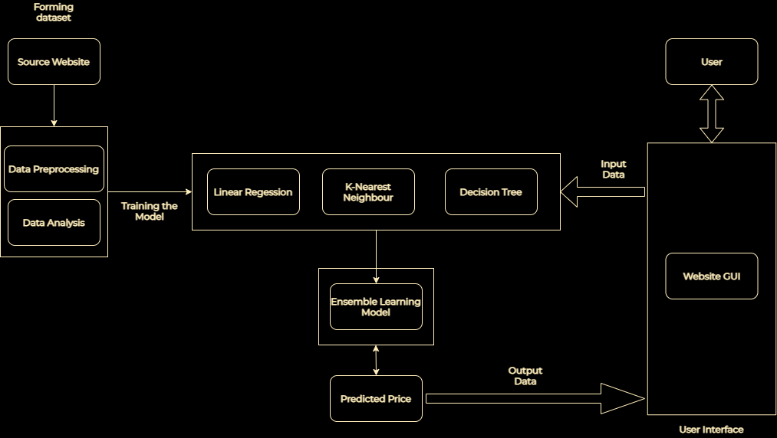
PROPOSED SYSTEM
DATA FLOW DIAGRAM

Slide 12
METHODOLOGY
DATA ANALYSIS
DATA COLLECTION WE NARROWED DOWN TO A DATASET FROM ‘KAGGLE.COM’ WHICH INCLUDED FAVORABLE PARAMETERS.
DATASET HAS 6345 DATA POINTS AND 20 COLUMNS INCLUDING PRICE, LOCATION, LOCATION ID, NO OF BEDROOMS, BUILT-UP AREA.. STUDYING THE DATASET

Slide 13
METHODOLOGY
DATA ANALYSIS
DATA VISUALIZATION WE USED GRAPHS LIKE PAIRPLOT, DISTPLOT, HEATMAP.
NULL VALUES IN THE LOCATION, PRICE, AREA, NO OF BEDROOMS COLUMN HAD
TO BE REMOVED. DATA CLEANING
DATA PROCESSING DEALING WITH LOCATION COLUMN, MAKING THE AVG-PRICE-AREA COLUMN AND DEALING WITH OUTLIERS

Slide 14
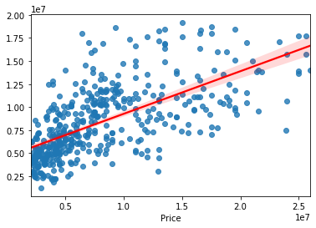
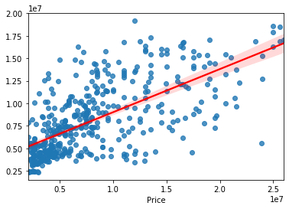
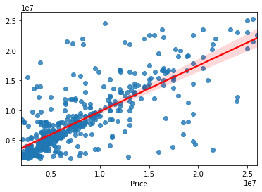

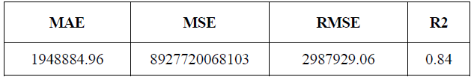
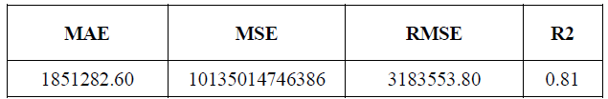
METHODOLOGY
MACHINE LEARNING
LINEAR REGRESSION
K-NEAREST NEIGHBOR
DECISION TREE

Slide 15
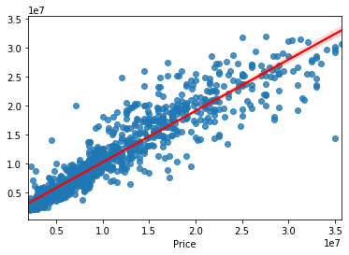
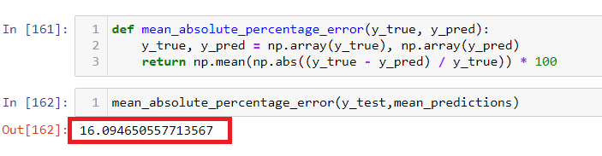
METHODOLOGY
MACHINE LEARNING
ENSEMBLE LEARNING METHOD

Slide 16
METHODOLOGY
MACHINE LEARNING
ALGORITHMS | LINEAR REGRESSION | K-NEAREST NEIGHBORS | DECISION TREE | ENSEMBLE
R2 SCORE | 0.83 | 0.84 | 0.81 | 0.87
MEAN SQUARED ERROR (MSE) | 9.2E+10 | 8.9E+10 | 1.0E+9 | 7.3E+10
ROOT MEAN SQUARED ERROR (RMSE) | 3040960.80 | 2987929.06 | 3183553.80 | 2694486.53
MEAN ABSOLUTE ERROR (MAE) | 2229371.20 | 1948884.96 | 1851282.60 | 1658701.38
WEIGHT | 0.1 | 0.3 | 0.6 | -

Slide 17
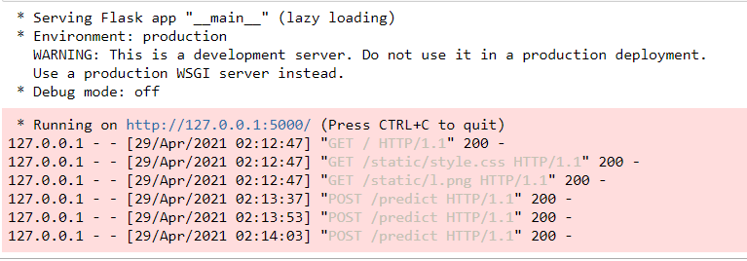
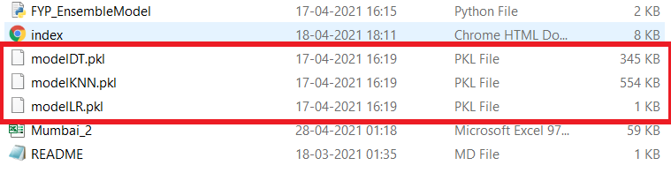
IMPLEMENTATION
WORKING
CREATING PICKLE FILES OF MACHINE LEARNING MODELS
CREATING AND DEPLOYING FLASK APPLICATION

Slide 18
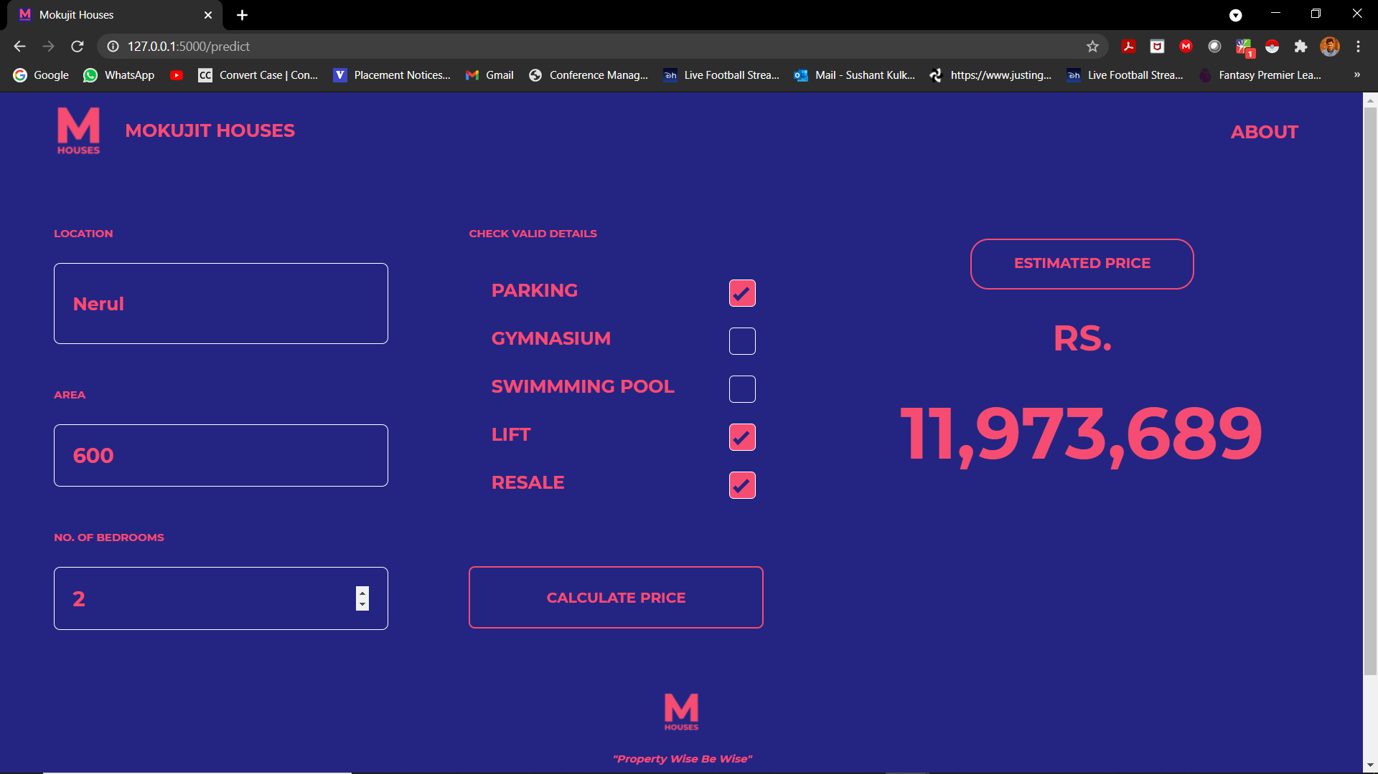
IMPLEMENTATION
RESULTS

Slide 19
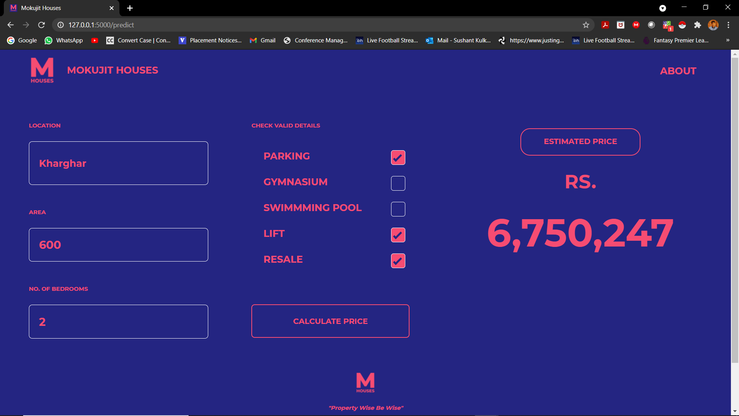
IMPLEMENTATION
RESULTS

Slide 20
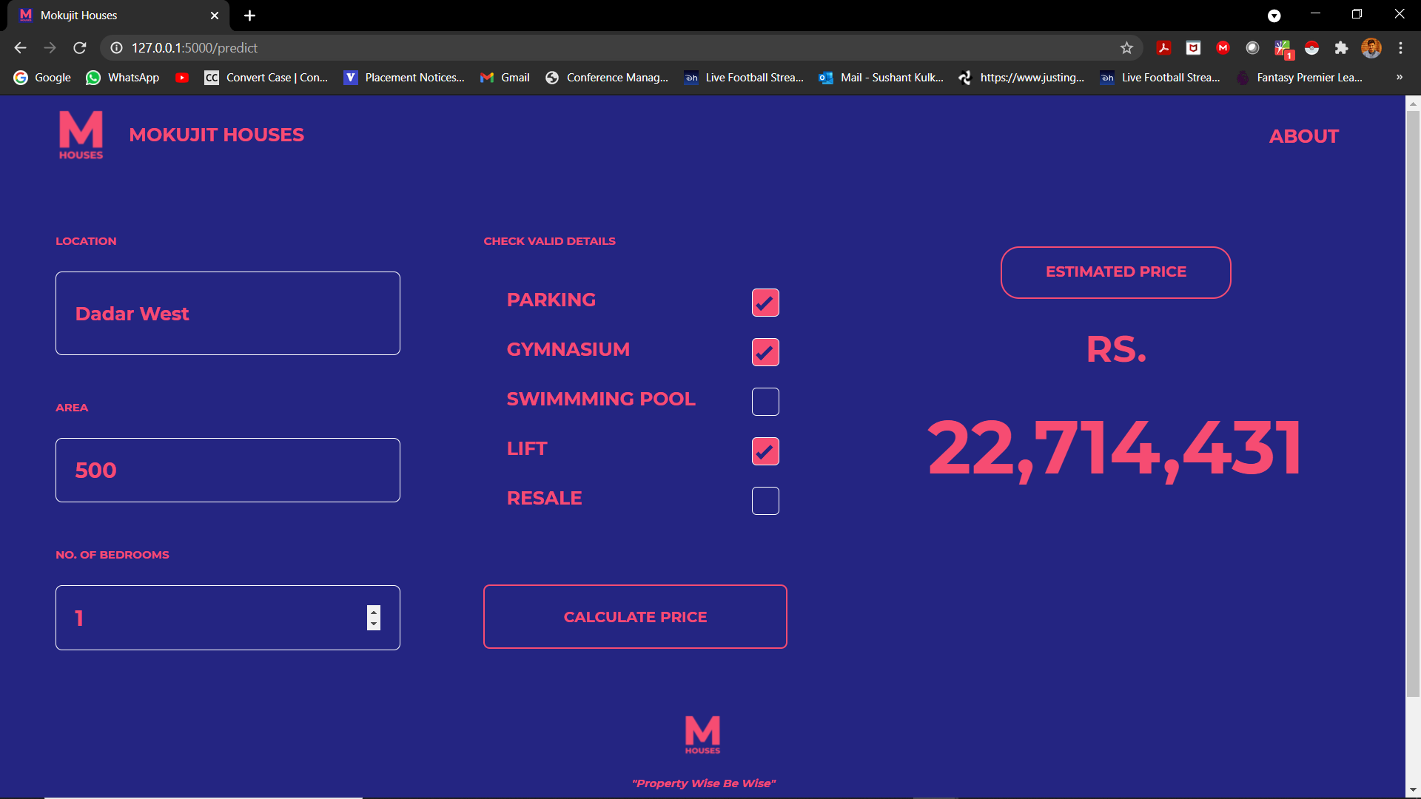
IMPLEMENTATION
RESULTS

Slide 21
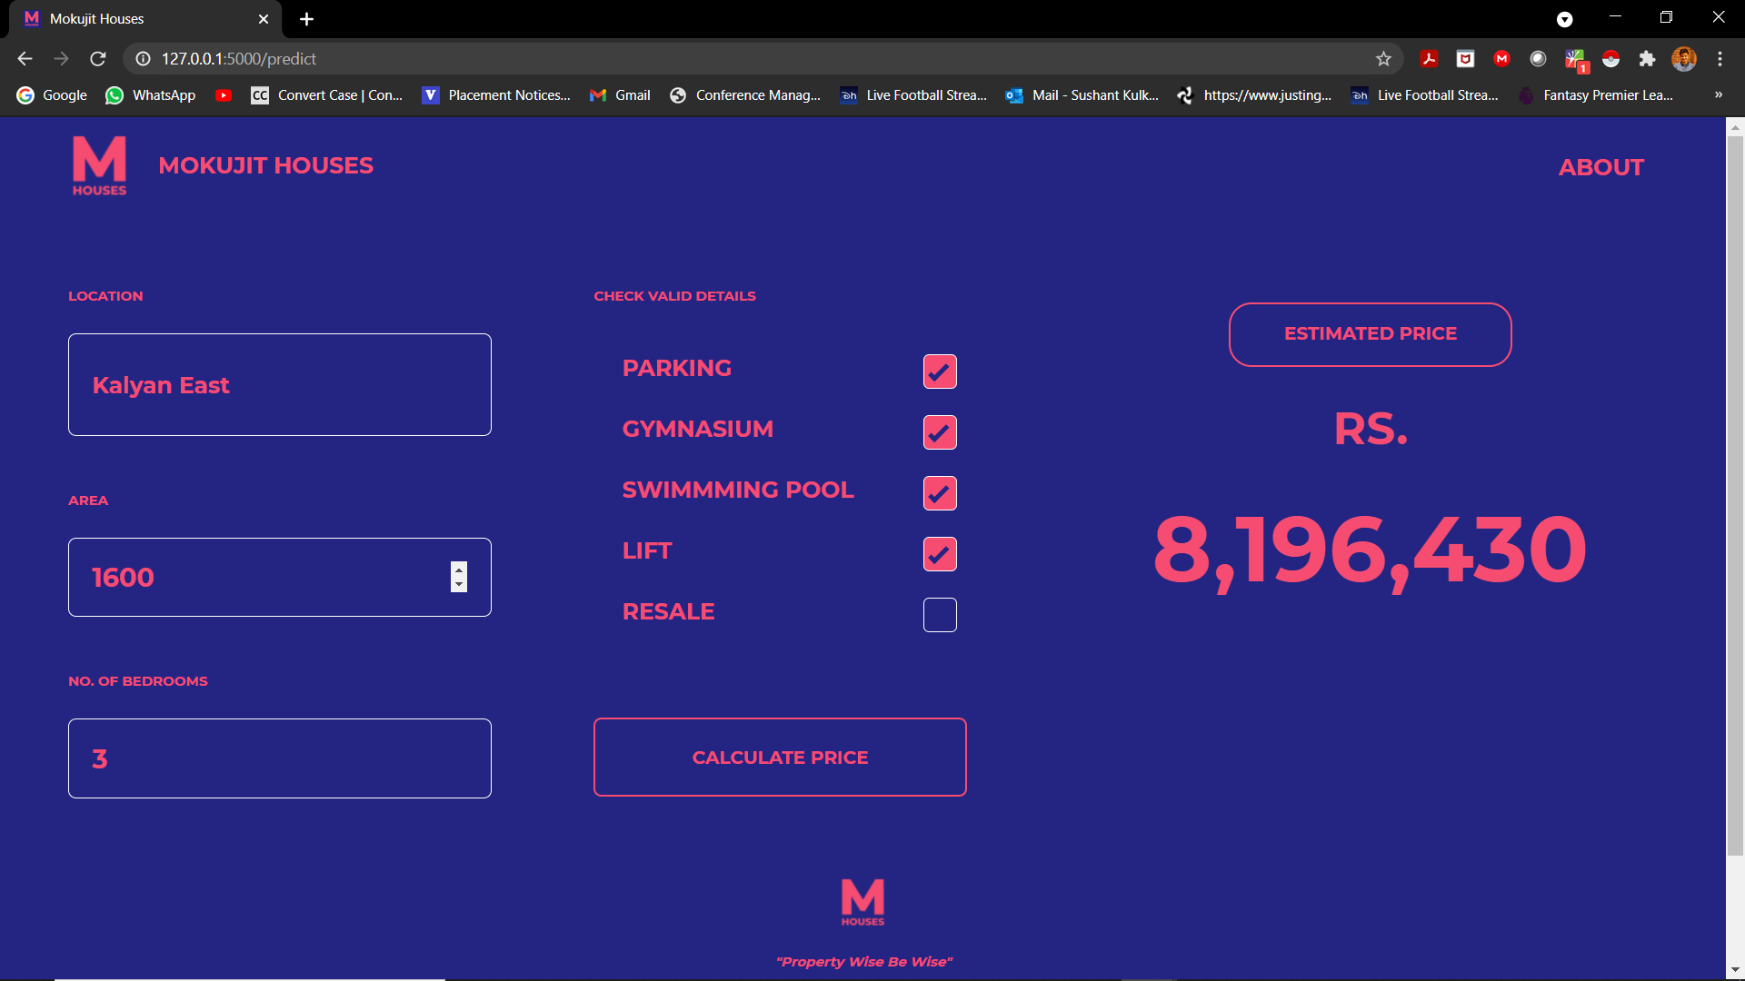
IMPLEMENTATION
RESULTS

Slide 22
REQUIREMENTS
HARDWARE
SOFTWARE
LAPTOP / PC
PYTHON 3+
JUPYTER NOTEBOOK
WEB BASED TOOLS
TENSORFLOW/KERAS
FLASK
PICKLE

Slide 23
THANK YOU

